Slide 1
Technical workshops – Awash Bank
Larry Kimata - Professional Services Consultant

Slide 2


Transaction Intelligence Powered by Intix & NetGuardians
Vyntra combines the best in AI-powered financial crime prevention and real-time transaction observability – setting a new benchmark for transparency, compliance and trust across every transaction
Build trust with real-time transparency
Reduce risk without slowing payments
Boost resilience and regulatory readiness
Trusted by 130+ institutions in 60+ countries

Slide 3
Technical discussions - Agenda
1
Architecture
2
Deployment options
3
Data collection framework
4
Data mapping

Slide 4
Architecture

Slide 5




Functional Architecture
Collect
Correlate
Analyze
Alert
Prevent
Real-time API
Log File data model
Analytics Platform
Investigation UI
business mapping
Profiling
Pattern-based Intelligence
Forensic Investigation
Batch Data Capture
Hit Dashboards
NG| PollingSystem
Behavioural Analysis
AI Risk Models
Case Management
NG|Import
Business Data Model
Anomaly Detection
Managed Learning
Hit Documentation
Transactions
Unsupervised Learning
Long term history
Channels
Supervised Learning
Workflow
Custom Data Ingestion
Reporting Framework
IT Layers
Graphical Rule Editor
Rule Engine
NoSQL Storage / Big Data Processing

Slide 6
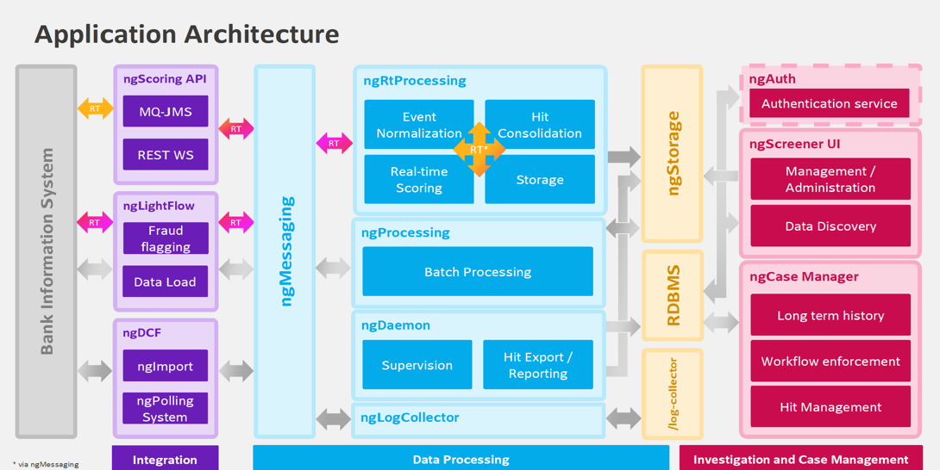

Slide 7
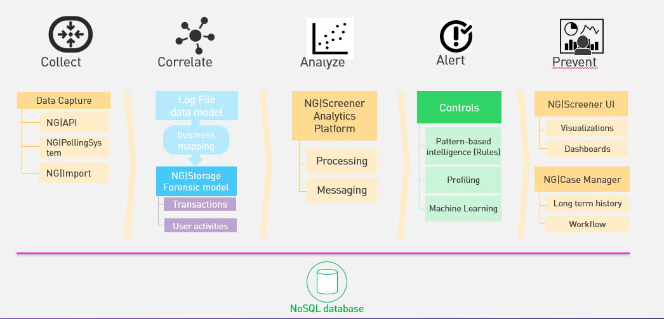
Technical Components

Slide 8
Platform Technical Architecture
User tier
Frontend
Web browser
Frontend (HTML/CSS)
Components (JavaScript)
NG|Screener UI
NG|CaseManager UI
Apache Proxy
JAX-RS / HTPPS
Backend
Components (Rails)
Components (Java)
Processing tier
NG|Scoring API
NG|Screener Daemon
Scheduler & asynch. executors
Business components
Etc.
syslog-ng
JDBC
HTTPS
Spark API
JDBC
NG|Messaging
NG|Processing
Data frames
Parquet
Storage layer
(temporary files)
MariaDb database
NG|Storage
ES Hadoop
/log-collector
/data (standard HDD)
/storage (high performance SSD)
Node.js
Java VM
RHEL/ Operating System

Slide 9
Deployment Options

Slide 10
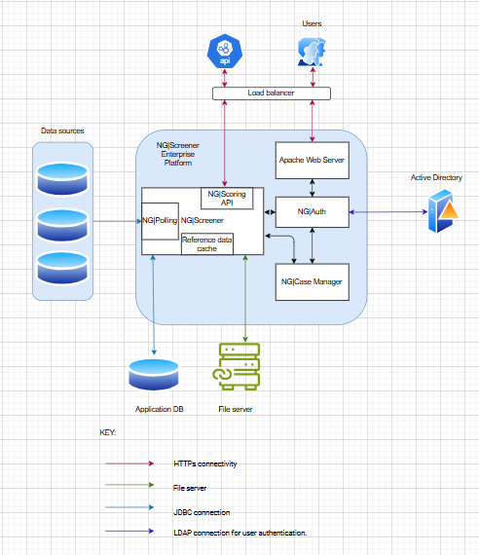
High level interfaces

Slide 11
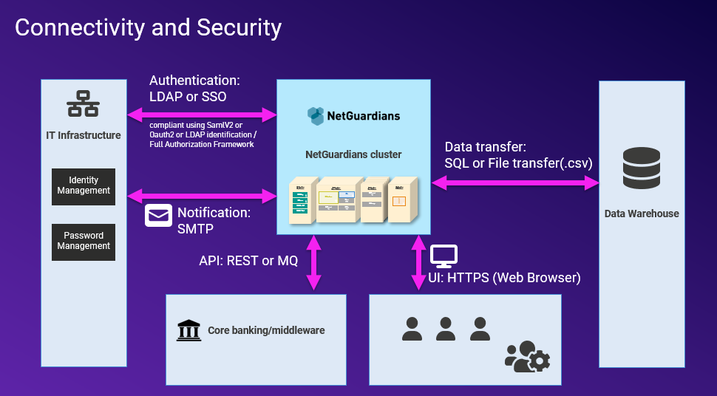

Slide 12
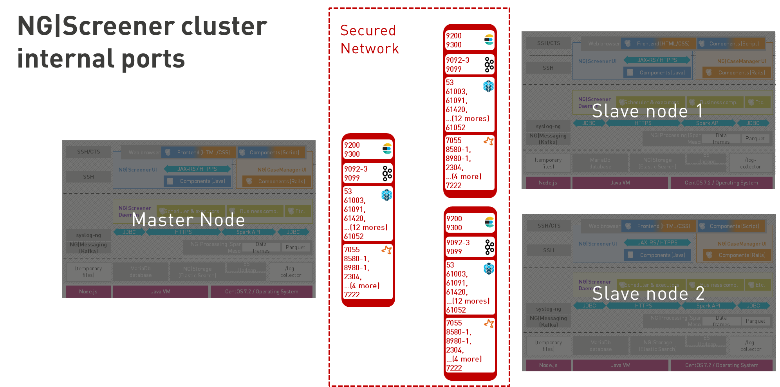

Slide 13
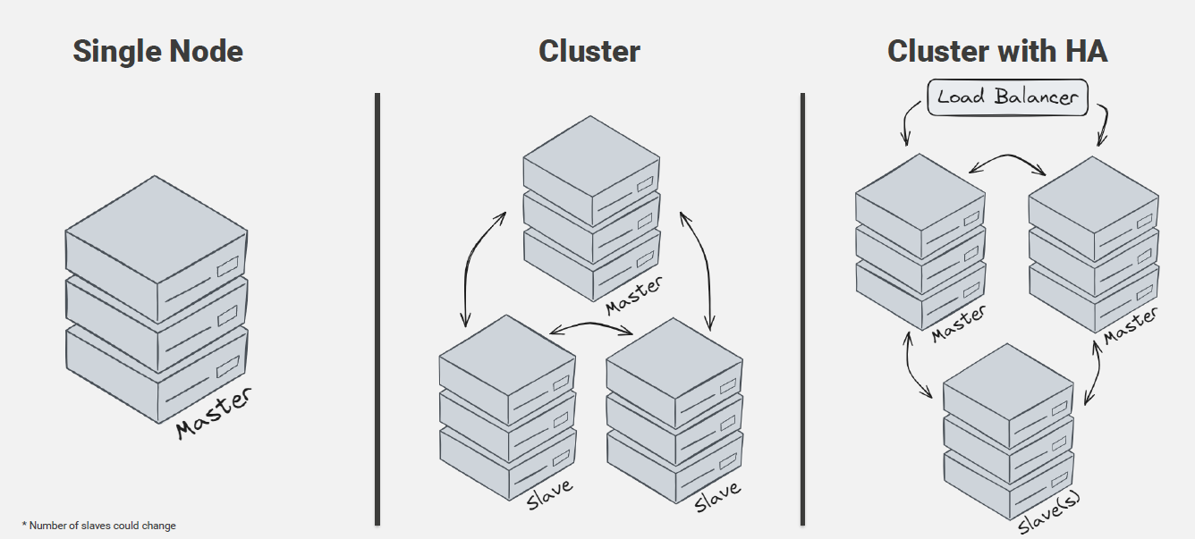
Deployment options

Slide 14
Deployment options – HA (requirements)
External DB for storing metadata and violations raised. DB should have its own HA.
Load balancer for routing requests to the active master node.
NFS share with guaranteed high availability.

Slide 15
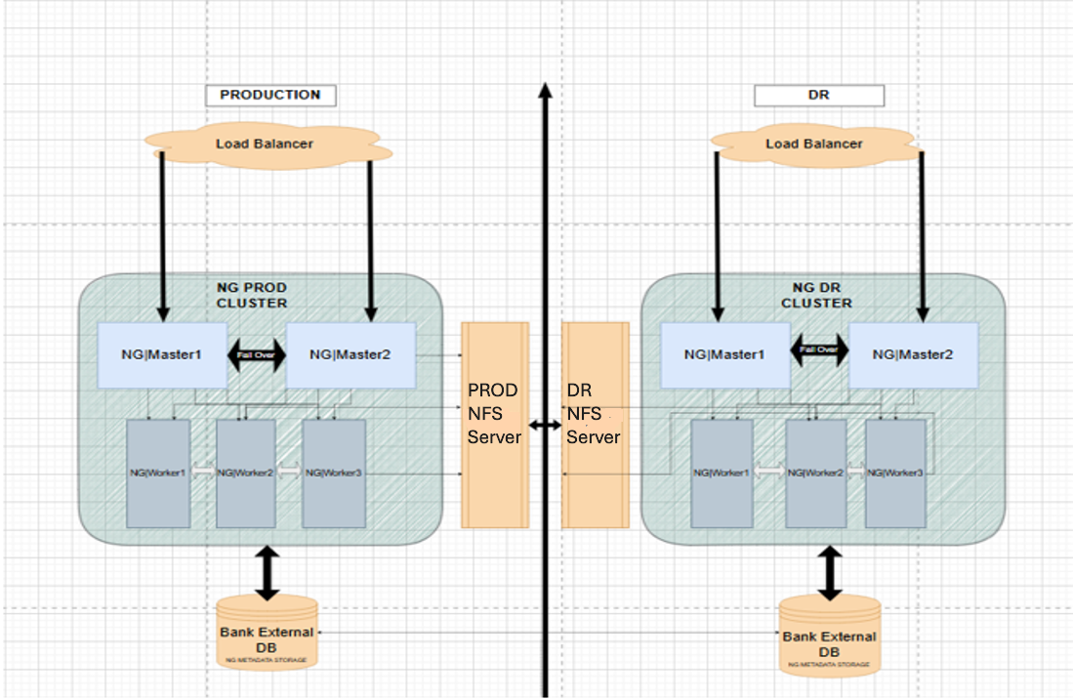
Deployment options HA

Slide 16
Deployment process
Ansible is an automation tool that allows you to automate tasks like provisioning, configuration management, and application deployment
The installation package contains the following items:
NG Software (rpms)
OS Dependencies
Ansible playbooks

Slide 17
Data Collection Framework

Slide 18
Introduction
Why Interfaces
Needed Interfaces
Nothing could be done without data
Need clever ways to connect to customer environment based on use cases
Ingest large amount of data
Building Profiles
Score Transaction
Query and response in Real-time
Enrich Data
To fill defined use cases
Flag Frauds
Feedback on real frauds

Slide 19
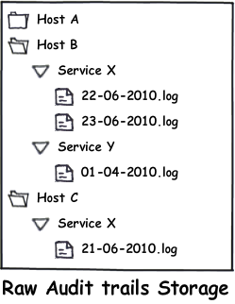
ngLogCollector – Consolidating data on file system
Data Storage
Audit trails are centralized under /log-collector directory
This folder is structured by Year / Host / Service
Filenames are formatted dd-mm-yyyy.log
Files get compressed after 2 days to gain space
Audit trails are compliant with Syslog log format

Slide 20
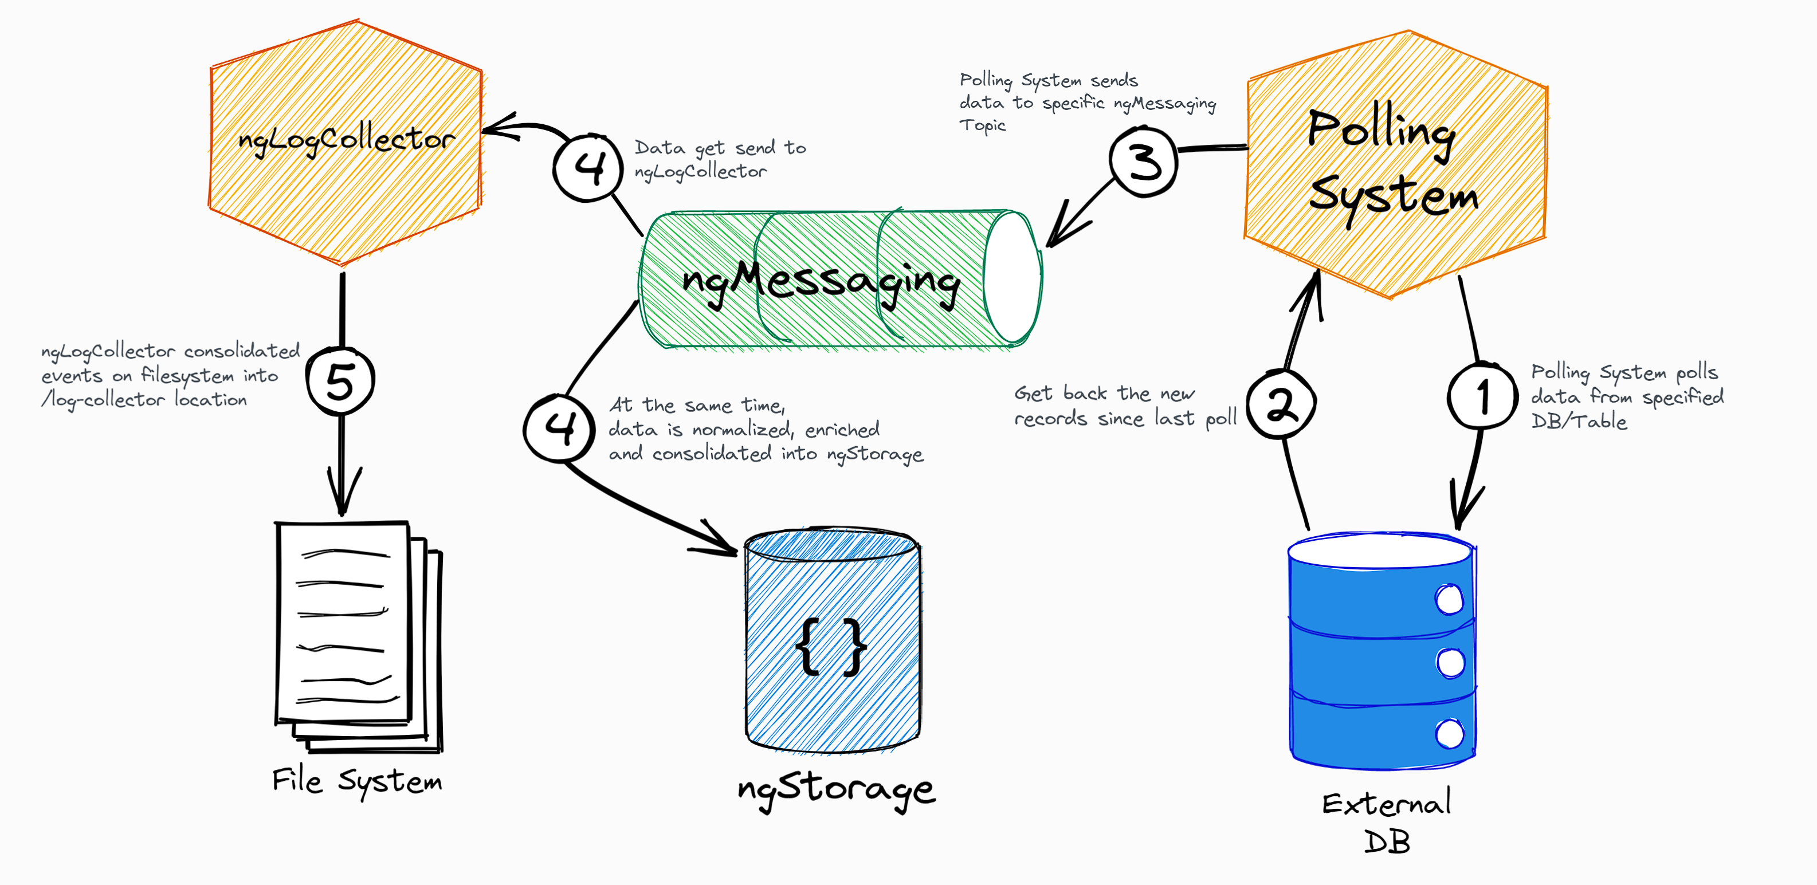
Database Polling

Slide 21
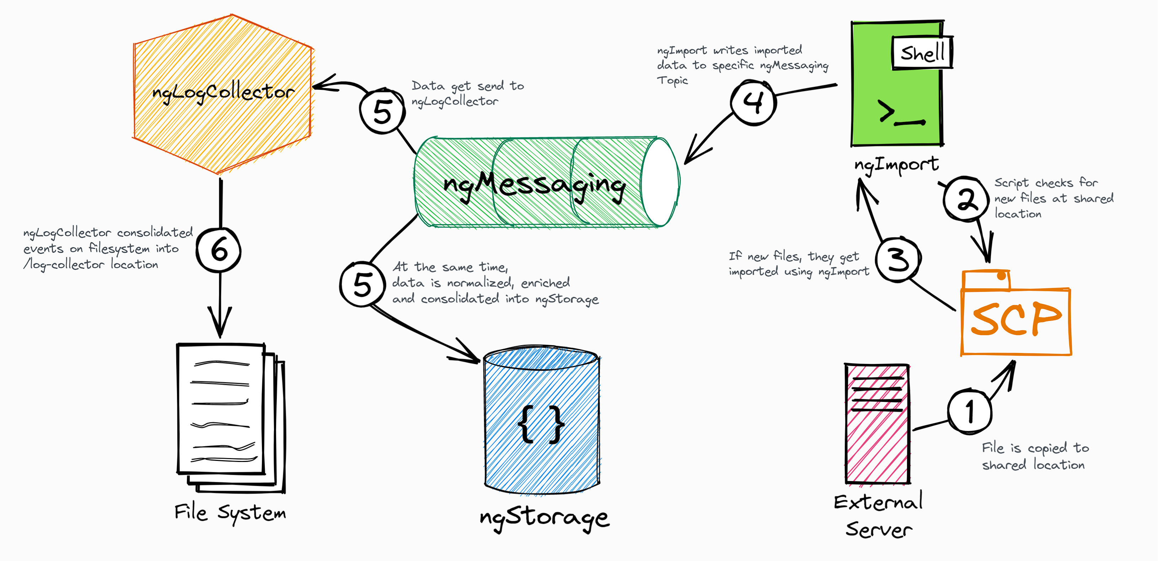
Flat file Import

Slide 22
Scoring API

Slide 23
Overview
Module providing an API for external systems.
Enabling the solution to score events (e.g. transactions) in a real-time fashion

Slide 24





Real-time Processing - Recap
Bank Information System
NG|Scoring API
RT
NG|RT Processing
RT
Event
Normalization
Dispatching
Real-Time Scoring (Controls)
Event Consolidation
MQ-JMS - Pull
RT
RT
RT
RT
RT
RT
RT
RT
WS/RS-* - Push
RT
Raw Events
Normalized Events
Dispatched Events (Per Control and Shard)
Raw Hits (Control)
Consolidated Hits
Dispatched Events (Per Control)
NG|LogCollector
/log-collector

Slide 25


Integration Layer
Scoring API endpoints
REST endpoint
Expose HTTP endpoint
JMS endpoint
Reading messages from a queue
Will not be covered in the slides
Each endpoint type could be enable/disabled separately

Slide 26

Workflow – Payment Not Suspicious
Core Banking
Payment Gateway
1. Payment Scoring Request
Scoring
API
2. Payment NOT suspicious
3. Release Payment

Slide 27
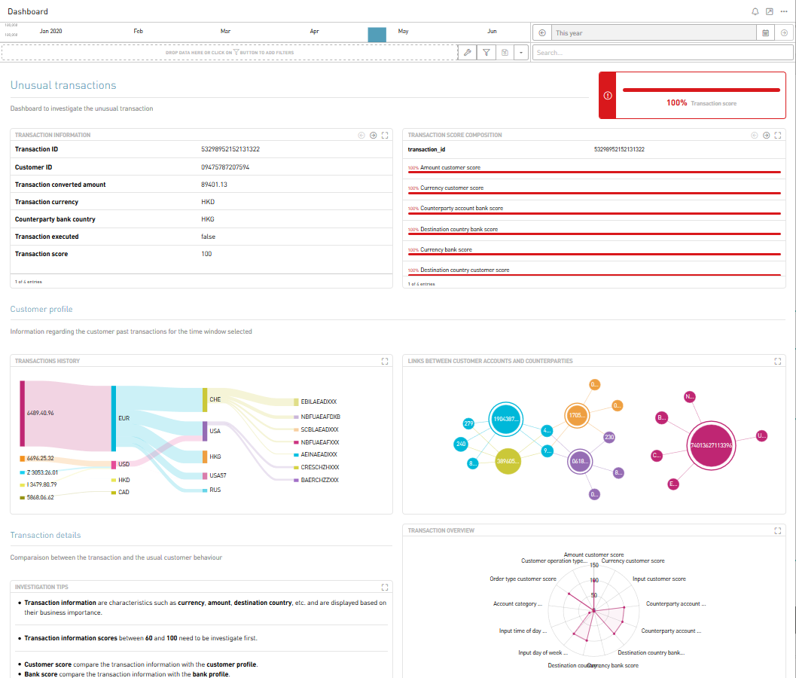
Workflow – Suspicious Payment
Fraud Investigator
Core Banking
Payment Gateway
1. Payment Scoring Request
Scoring
API
2. Payment suspicious
3. Review Needed
4. Fraud Investigator Checks Payment
NG|UI
5a. If OK, Releases Payment
6a. Payment Released
Flagging
API
5b. If NOK, Block Payment
6b. Confirm Fraud

Slide 28
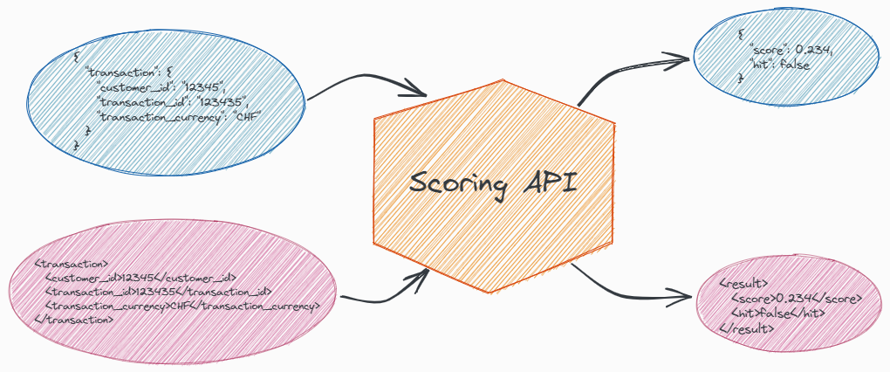
Incoming:
JSON
XML
SWIFT
ISO20022
Outgoing
JSON
XML
Template available to create your own response

Slide 29
Output
Scoring API will provide direct feedback to external system
If publishing is configured, it will also create data in log-collector as well as in ES (NG|Storage)

Slide 30
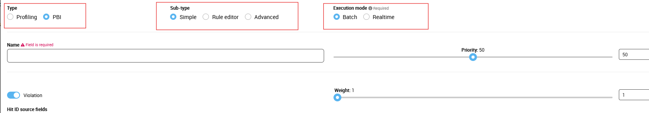
Control types
Controls types – Profiling or PBI
Control sub types - simple or rule editor or advanced.
Control execution mode - Realtime (RT) or batch
RT controls support simple mode only.

Slide 31
API endpoints
Data is separated by type (transaction or user activity) and source (CBS/IB/MB…)
Number of endpoints will be determined by:
Data acquisition mode that will be decided on.
Data type
Data sources
Number of controls
Control run schedule

Slide 32
Data Mapping

Slide 33
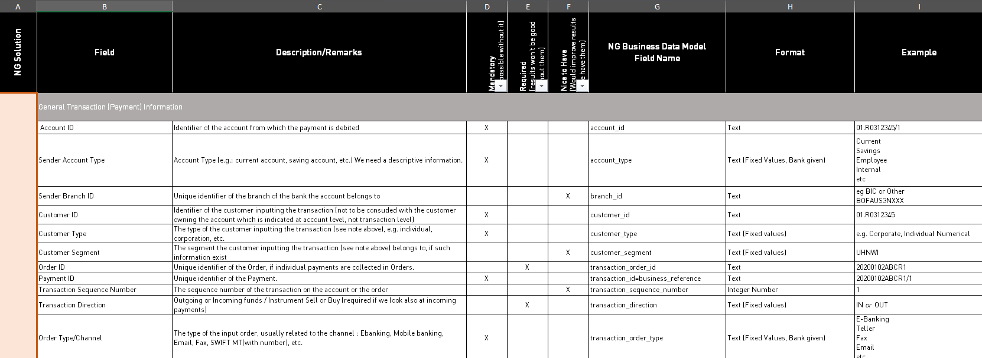
Data mapping
Excel – CBS, Internet Banking, Mobile Banking, Card System, Swift

Slide 34
Summary
Architecture
Integration
Data mapping

Slide 35
Next Steps
Data mapping after FSD
Deployment of appliance after fulfillment of prerequisites.
Deployment done using Ansible.

Slide 36
larry.kimata@vyntra.com
https://www.linkedin.com/in/larry-kimata-775758188/

